Slide 1


Joined up policies, joined up journeys:
Roadmapping accessible transport for the UK and devolved nations
July 2025
Insights report

Slide 2


About ncat
The National Centre for Accessible Transport (ncat) works as an Evidence Centre developing high quality evidence, best practice and innovative solutions to inform future disability and transport strategy, policy, and practice by:
ncat is delivered by a consortium of organisations that includes Coventry University, Policy Connect, The Research Institute for Disabled Consumers (RiDC), Designability, Connected Places Catapult, and WSP. It is funded for seven years from 2023 by the Motability Foundation.
For more information about ncat and its work please visit our website www.ncat.uk
To contact ncat, either about this report or any other query, please email info@ncat.uk
Engaging with disabled people to better understand their experiences and co-design solutions
Amplifying the voices of disabled people in all decision-making
Collaborating widely with all transport stakeholders
Demonstrating good practice and impact to influence policy

Slide 3

What is ncat?
We work directly with disabled people to undertake research and develop solutions
We centre the voices of disabled people in our decision-making and collaborate widely with transport stakeholders, disability organisations, and policy makers
We follow the social model of disability, where disability refers to the restrictions caused by society
We lead with good practice and impact to influence policy
We embrace equality, diversity and inclusivity

Slide 4

Accessible Transport Policy Commission
Parliamentarians, disabled people, transport professionals and policymakers.
Chair: Baroness Tanni Grey-Thompson (Crossbench)
Secretariat provided by Policy Connect.

Slide 5
Why did we do this work?
Disabled people make 38% fewer journeys than non-disabled people, a trend that has persisted for over a decade¹
ncat’s Understanding and Identifying Barriers to Accessible Transport report shows that 92% of disabled people face barriers when using at least one mode of transport.²
The characteristics of the different transport systems and the policy and regulatory processes that shape them differ between England, Northern Ireland, Scotland, and Wales.³
_{1.} Motability, The Transport Accessibility Gap, 2022
_{2.} ncat, Understanding and identifying barriers to accessing transport, 2024
_{3.} Transport Scotland, Disability and Transport 2021, and The Northern Ireland Transport Accessibility Statistics, 2024, and Transport For All, 'Are We There Yet? Barriers to transport for disabled people in 2023'

Slide 6







Interested in all forms of transport
Active travel
Air travel
Sea travel
Rail travel
Road travel

Slide 7
What did we do?
Scoping: Review of UK-wide research, policy, and legislation; engagement with Disabled People’s Organisations, advisory panels, and transport professionals.
Call for Evidence: Qualitative survey through the Community of Accessible Transport Panel.
Policy roundtables: Online evidence sessions for each nation, and on regulation, chaired by parliamentarians.

Slide 8
Call for Evidence
9 questions for each nation, participants could give evidence for multiple nations
The topics included: collaboration between governments, regulation, areas neglected in policy, and co-production with disabled people.
Participants could respond in the text box, by submitting audio and visual media, and over the phone.

Slide 9
Call for Evidence Responses
953 respondents in total, 346 did not answer any of the research questions.
607 respondents after data cleaning.
578 respondents identified as disabled (n= 547) or having some sort of condition/disability/impairment (n= 31).

Slide 10
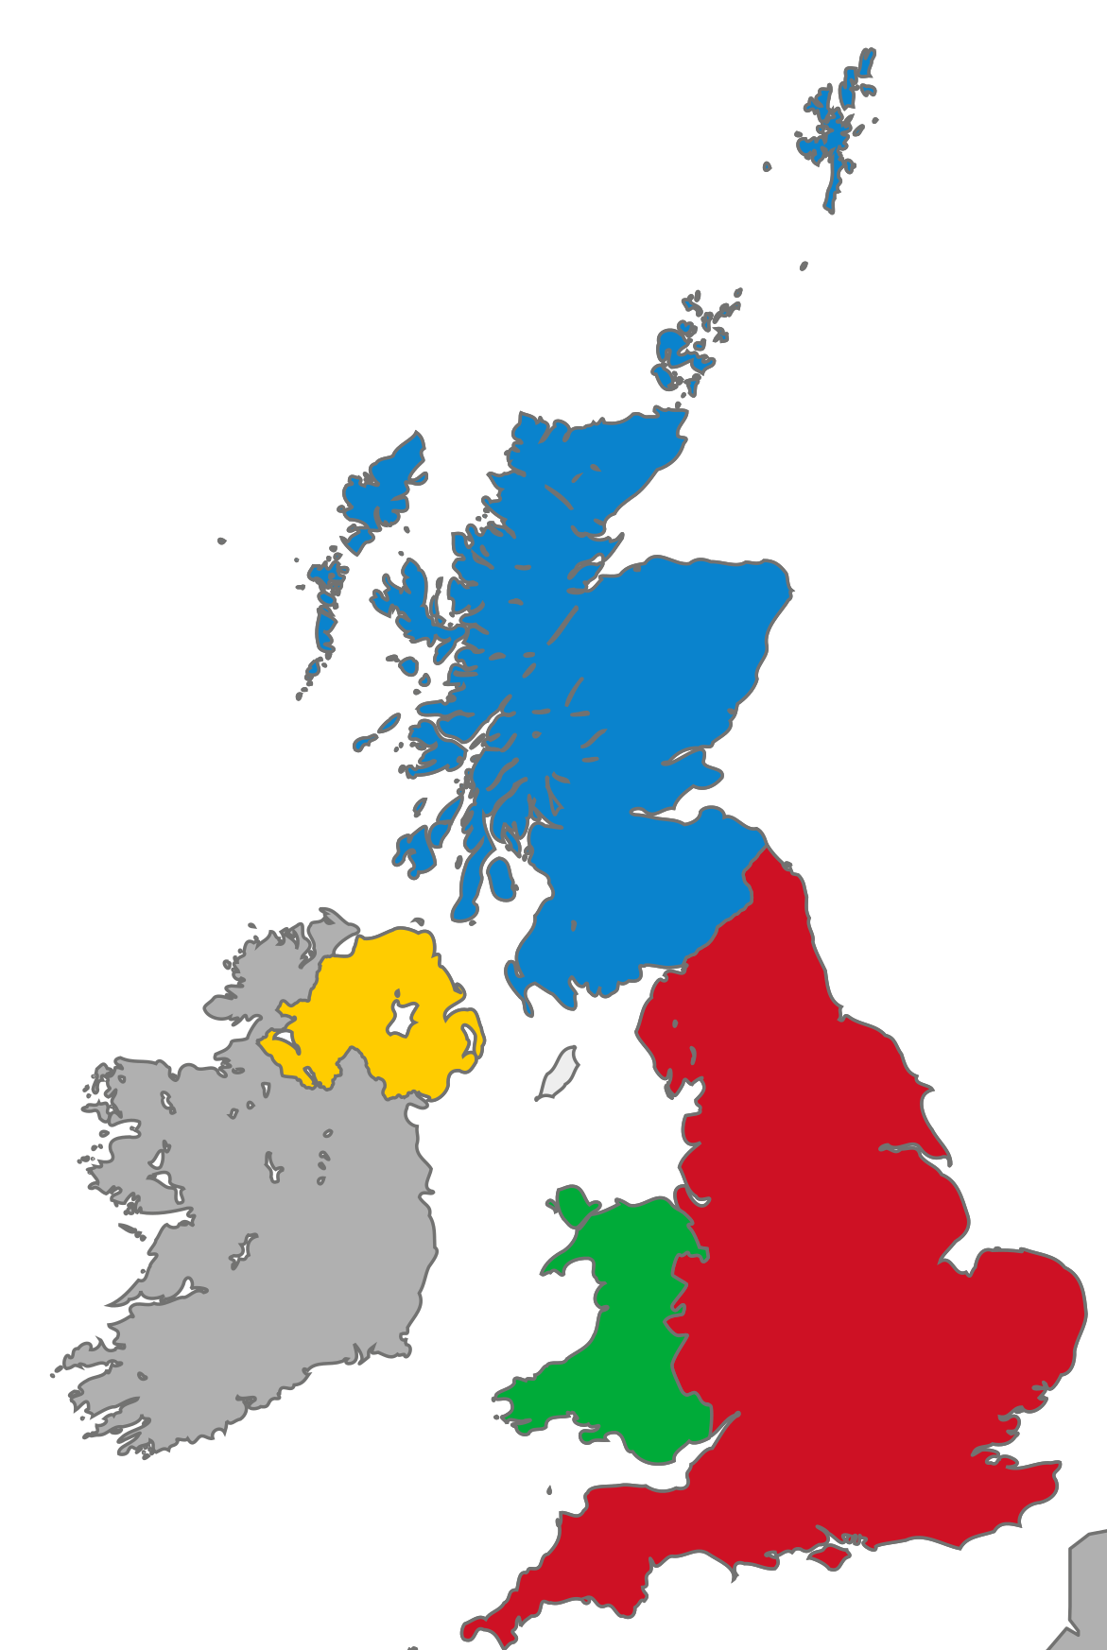
Call for Evidence Responses (map)
Scotland: 56
Total: 607
Northern Ireland: 7
England: 464
Wales: 42
UK-wide: 57

Slide 11
Policy Roundtables
Roundtable | Chair | Panellists | Number of attendees
Wales | Baroness Grey-Thompson | Disability Rights Taskforce Working Group on Travel; Gig Buddies Cymru; Transport for Wales | 8
England | Lord Shinkwin | Transport for All; Bus Users UK; Chartered Institution of Highways & Transportation | 25
Scotland | Richard Baker MP | Royal National Institute of Blind People Scotland; Lothian Buses | 17
Northern Ireland | Sorcha Eastwood MP | The Inclusive Mobility and Transport Advisory Committee; Disability Action Northern Ireland; Consumer Council | 9
UK-wide Regulation | Baroness Brinton | Office for Road and Rail; Civil Aviation Authority; Maritime and Coastguard Agency | 19

Slide 12
What did we find?
Finding 1: The UK lacks cohesive, inclusive transport strategies and coordination across nations
Finding 2: Seamless door-to-door journeys are hindered by a lack of integration between different transport modes and services
Finding 3: Accessible transport standards are fragmented and limited
Finding 4: The lack of co-production in decision-making processes often leads to accessibility being treated as an afterthought
Finding 5: Transport regulators don't have enough powers, capacity and visibility to fulfil their responsibilities around accessibility.

Slide 13
Finding 1
The UK lacks cohesive, inclusive transport strategies and coordination across nations.
Governance is fragmented, frameworks are outdated, and policy delivery is inconsistent.
Disabled people’s access to transport is like a “postcode lottery”.
Those from rural areas and those marginalised and lower socioeconomic backgrounds are disproportionately impacted.

Slide 14
A disabled respondent to the Call for Evidence
“Transport isn't just transport, it's the economy, employment, planning, housing, health, the arts and culture - it's the thread through all.”
A disabled respondent to the Call for Evidence

Slide 15
Finding 2
Seamless door-to-door journeys are hindered by a lack of integration between different transport modes and services
Poor integration between transport modes creates major obstacles.
Transition disruptions include inaccessible journey information, poor street infrastructure, and uncoordinated transport schedules.
Challenges intensify for those who cannot easily arrange alternatives, such as deaf passengers needing taxis during cancellations, or those in rural areas.

Slide 16
Quote from Lucy Vallis, CEO of Possability People
“Policies fail to ensure seamless accessibility across the entire journey, including from home to the station and back again. A more holistic approach, like integrating local transport services like buses, taxis, and cycling schemes should be included in accessibility plans.”
Lucy Vallis, CEO of Possability People

Slide 17
Finding 3
Accessible transport standards are fragmented and limited
      The availability of accessible transport guidelines and standards varies by sector and nation.
Practices differ among providers within the same sector.
Without standards, costly retrofitting becomes necessary.
The burden is put on disabled people to navigate inconsistent standards.

Slide 18
Quote from Deborah Preston, Access Advisor at the Liverpool City Region Combined Authority
“There needs to be a minimised set of standards for accessible transport and needs to ensure that no matter where you travel to throughout the UK all transport routes and means of transport are accessible.”
Deborah Preston, Access Advisor at the Liverpool City Region Combined Authority

Slide 19
Finding 4
The lack of co-production in decision-making processes often leads to accessibility being treated as an afterthought
Disabled people are frequently excluded from decision-making processes that shape transport policy and infrastructure.
Local and national access groups vary in power and permanence, creating inconsistency.
Without formal structures, funding, and accountability, disabled people’s input is undervalued, and their expertise underutilised.

Slide 20
Quote from Claire Walters, Bus Users UK
“We keep talking about ‘nothing about us without us’ but everything seems to happen without us half the time, and we only find out afterwards. We need to have a statutory right to information at the early stage rather than a consultation once they have made up their mind.”
Claire Walters, Bus Users UK

Slide 21
Finding 5
Transport regulators don't have enough powers, capacity and transparency to fulfil their responsibilities around accessibility
Transport regulation is fragmented and varies in its effectiveness.
Disabled people in Northern Ireland have fewer legal protections.
Some regulators can fine providers, while others rely on public pressure.
The public perception of regulators is often negative, with many seeing them as ineffective or complicit in inaccessible practices.
Many regulators lack engagement with disabled people, and capacity.

Slide 22
Quote from Matt Harrison, Thomas Pocklington Trust
“Regulators need to work more closely with those affected. It should be a requirement that providers hold access panels and request feedback from various groups, and that this evidence is shared with the regulatory bodies themselves.”
Matt Harrison, Thomas Pocklington Trust

Slide 23
Conclusions
There is a need for integrated cross-modal and cross-departmental inclusive transport strategies across the UK.
There is a need for UK-wide standards for each mode of transport.
For standards to be successful, regulation of transport accessibility must be effective through stronger powers, engagement with disabled people, and transparency.
Every stage of policy and project delivery must be co-produced with disabled people.

Slide 24

UK-wide Recommendations
Accessible Transport Standards Commission
Department for Transport to establish and invite devolved nations to set and review transport infrastructure and service standards.
Disability Transport Taskforce
Departments overseeing transport to coordinate their accessible transport frameworks and share best practice.

Slide 25
Roadmap: Department for Transport
Year 1: Strategy Development, Foundations, and Co-production
Year 2-3: Reform, Standards, and Delivery
Year 4-5: Transparency and Evaluation
Accessible Transport Framework with Disabled People’s Access and Inclusion Panel
Cross-departmental ministerial taskforce
Commission a standards review
Local Accessible Transport Charter.
Accessible Transport Standards Commission
UK-wide Disability Transport Taskforce
Equality Act reform
Regulatory transparency and powers.
Review of the standards
Annual access enforcement summary of the standards.

Slide 26
Roadmap: Welsh Government
Year 1: Strategy and Co-production
Year 2-3: Reform, Standards, and Delivery
Year 4-5: Transparency and Evaluation
Disabled People’s Access and Inclusion Panel
Co-produced Accessible Transport Plan for Llwybr Newydd
Accessibility training for Transport for Wales staff.
Accessible Transport Standards Commission
UK-wide Disability Transport Taskforce
Local access panels.
Review of the standards
Annual access enforcement summary shared with Disabled People’s Access and Inclusion Panel and the Taskforce.

Slide 27
Roadmap: Transport Scotland
Year 1: Strategy and Co-production
Year 2-3: Reform, Standards, and Delivery
Year 4-5: Evaluation and Enforcement
Begin co-producing the Accessible Travel Framework
Cross-departmental ministerial taskforce
Strengthen the Access Panel Network.
Join the Accessible Transport Standards Commission
UK-wide Disability Transport Taskforce
Mandate training within Transport Scotland.
Review of the standards
Annual access enforcement summary of the standards.

Slide 28
Roadmap: Department for Infrastructure
Year 1: Strategy and Co-production
Year 2-3: Reform, Standards, and Delivery
Year 4-5: Evaluation and Enforcement
Co-produce an inclusive transport strategy with the Inclusive Mobility and Transport Advisory Committee
Cross-departmental ministerial taskforce
Set up more community access panels.
Accessible Transport Standards Commission
UK-wide Disability Transport Taskforce
Disability Discrimination Act 1995 reform
Mandate training within the Department for Infrastructure.
Review of the standards
Annual access enforcement summary of the standards.

Slide 29
References
Motability Foundation (2022) Transport Accessibility Gap Report. Available at: https://www.motabilityfoundation.org.uk/media/iwaidhxk/motability_transport-accessibility-gap-report_march-2022_final.pdf
National Centre for Accessible Transport (2024) Understanding and Identifying Barriers to Transport. Available at: https://www.ncat.uk/wp-content/uploads/2024/12/ncat-Understanding-and-identifying-barriers-to-accessing-transport-Full-Report-Accessible-PDF-FINAL-1.pdf
https://www.transport.gov.scot/media/jzxntw2c/disability-and-transport-2021.pdf
https://www.infrastructure-ni.gov.uk/news/transport-accessibility-statistics-northern-ireland-report-has-been-published-today
https://www.transportforall.org.uk/wp-content/uploads/2023/12/Are-we-there-yet_Highlights_PDF-web-compressed-more-compressed.pdf
Notes:
Motability Foundation (2022) Transport Accessibility Gap Report. Available at: https://www.motabilityfoundation.org.uk/media/iwaidhxk/motability_transport-accessibility-gap-report_march-2022_final.pdf
National Centre for Accessible Transport (2024) Understanding and Identifying Barriers to Transport. Available at: https://www.ncat.uk/wp-content/uploads/2024/12/ncat-Understanding-and-identifying-barriers-to-accessing-transport-Full-Report-Accessible-PDF-FINAL-1.pdf

Slide 30

Key insights
This report just gives key insights.
The Full Report as well as easy-read and BSL versions of the highlights are available at www.ncat.uk/what-we-do/projects
ncat encourage you to freely use the data available in this report for your research, analyses, and publications. When using this data, please reference it as follows to acknowledge ncat as the source: ‘ncat (2025). Joined up policies, joined up journeys: Roadmapping accessible transport in the UK and devolved nations. Available at www.ncat.uk’

Slide 31
Contacts
ncat website: www.ncat.uk
LinkedIn: www.linkedin.com/company/ncat-uk
Email: info@ncat.uk

