Slide 1
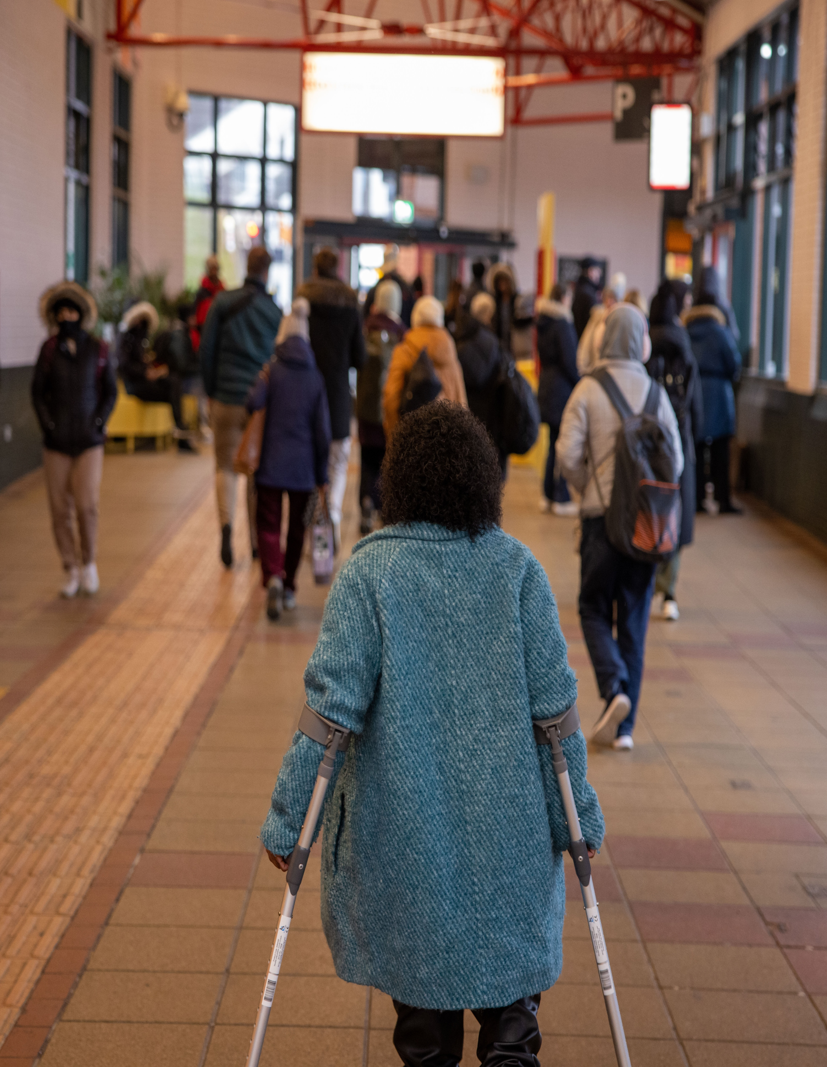

Invisible barriers: how public attitudes affect inclusive travel Findings from focus groups with disabled people Key Insights
July 2025

Slide 2


About ncat
The National Centre for Accessible Transport (ncat) works as an Evidence Centre developing high quality evidence, best practice and innovative solutions to inform future disability and transport strategy, policy, and practice by:
ncat is delivered by a consortium of organisations that includes Coventry University, Policy Connect, The Research Institute for Disabled Consumers (RiDC), Designability, Connected Places Catapult, and WSP. It is funded for seven years from 2023 by the Motability Foundation.
For more information about ncat and its work please visit our website www.ncat.uk
To contact ncat, either about this report or any other query, please email info@ncat.uk
Engaging with disabled people to better understand their experiences and co-design solutions
Amplifying the voices of disabled people in all decision making
Collaborating widely with all transport stakeholders
Demonstrating good practice and impact to influence policy

Slide 3

Why did we do this work?
ncat surveyed 1,195 disabled people about the barriers they experienced while travelling and found that 59% of disabled people experience negative attitudes from when travelling, across all modes of transport. The survey showed that the effects of negative attitudes are a significant barrier for disabled people when using transport. (ncat 2023)
When referring to negative attitudes, we mean the negative thoughts, feelings and behaviours people have towards disabled people.
ncat was interested in exploring the experience of the 59%, to understand what these negative attitudes are, how they affect disabled people when travelling and what interventions disabled people think would help.
We undertook Focus Groups to look at this.
This report is part of a series of research conducted by the National Centre for Accessible Transport (ncat) since its launch as an Evidence Centre in early 2023. Whilst this is a standalone report, we would recommend it is considered alongside other ncat research published from late 2024. As ncat progresses further, reports and insights will also be published on our website www.ncat.uk

Slide 4

The Focus Groups: What did we do?
Three online focus groups (via Zoom), each including three-to-six participants. A total of 14 participants took part. Participants were part of the 59% who had told us in our previous survey on transport barriers that they had experienced negative attitudes when travelling.
The focus groups were categorised loosely by participants’ impairment types and access needs: mobility, cognitive and sensory impairments.
Although almost all participants had more than one impairment or access need, we planned each discussion to focus primarily on one of the three broad impairment categories.
The focus groups discussed the types of attitudes disabled people experience whilst using all modes of transport. Participants also talked about the impact of negative attitudes and their recommendations for how negative attitudes could be improved.

Slide 5
What are the attitudinal barriers disabled people experience?
The public and transport staff have a very limited understanding of disability
Young disabled people experience negative treatment because members of the public don’t believe that young people can have access needs.
People with non-visible impairments and access needs experience disbelief and less help and support than people using assistance aids. Many participants explained how they’d experienced a noticeable difference in how transport staff and other passengers treated them when using – or not using – assistance aids. Some felt their access needs were treated more seriously when they ‘looked’ disabled (such as using a white cane, assistance dog, walking stick or wheelchair).
Frontline transport staff sometimes do not support disabled people’s independence and do not to provide equitable treatment
Staff don’t always respect disabled people’s agency. Participants described feeling ignored and not listened to by members of staff, who often made decisions for the passenger without consulting the individual.
Other passengers are sometimes abusive towards disabled people using transport
Many participants have memorable experiences concerning verbal abuse from other passengers, with many receiving threats of physical violence. Participants described being sworn at, laughed at, forced off a train, their carers being threatened and intimidated and being called derogatory and dehumanising names.

Slide 6
Where do disabled people think these negative attitudes come from?
Politics and news media play a significant role in shaping negative attitudes towards disabled people
Contemporary politics and media portray disabled people in a negative light. Participants felt that politicians portrayed disabled people as “scroungers” and as societal “baggage” and that this filtered down into the general public’s perception of disabled people.
There is a lack of nuanced representation of disabled people in media. Participants highlighted how most stories or sentiments they see about disabled people are either through a negative benefits lens or through a lens of what is called “inspiration porn”.
Structural and service barriers contribute to the poor treatment and discrimination from staff
Current transport barriers foster uncooperative behaviours from transport staff. Participants highlighted how they often felt that transport staff didn’t know, or want to know, how to deal with physical access barriers. This resulted in tense and unhelpful interactions with transport staff, where disabled people felt overlooked or discriminated against.
There are not enough staff members to deal with the needs of all passengers. Focus group participants expressed that staff weren’t always available to help at stations or on board trains or buses.

Slide 7
What are the impact of attitudinal barriers on disabled people?
The negative attitudes that disabled people face when using transport have alarming implications on their mental health and confidence
Participants expressed feeling anxious and scared when using public transport. Some participants discussed how the negative interactions with staff members and other passengers had led to panic attacks, dissociation, and feeling suicidal. These barriers and experiences actively harmed their sense of confidence.
Disabled people are not using certain transport modes, are travelling less and are not feeling able to travel independently because of negative attitudes
Disabled people told us how they leave the house less because they did not want to face the negative attitudes alone.
Some participants expressed avoiding public transport altogether. As a result of the access barriers and numerous negative experiences with staff and members of the public, some participants actively chose to use private transport whenever they could.
Participants’ desire for independent travel was at odds with the realities of using public transport. Participants expressed frustration at not being able to travel without having someone accompany them because of the physical barriers and negative attitudes they faced.

Slide 8
“Sometimes it's just easier to just stay at home and not even try. But like people say, I want to have a life, I want to get out, but it just takes a lot of energy and a lot of courage sometimes.”
Participant with hearing, dexterity and learning impairments

Slide 9

Recommendations from disabled people
Collaboration with disabled people is critical in the design of transport infrastructure and improving attitudes
Education and awareness-raising through humanising disabled people, along with increasing understanding about disability and barriers, are key aspects for improving public attitudes
Political and social change and a commitment to improving attitudes towards disabled people need to ‘come from the top’

Slide 10
Quote from Participant with mobility, hearing, vision, cognitive and continence impairments
“When making these decisions, don't assume that you know what we need. And also remember that all these different disabilities are different, and everyone is affected differently. So, if they're doing some kind of project, they need to make sure they're covering mental health, neurodivergence, physical disabilities, sensory disabilities, dementia, you know, all these different sort of areas of disability […] And just work with us rather than going, ‘Oh, yeah, that will fix it’, you know, without actually consulting the community you're trying to help.”
Participant with mobility, hearing, vision, cognitive and continence impairments

Slide 11
Contacts
ncat website: www.ncat.uk
LinkedIn: www.linkedin.com/company/ncat-uk
Email: info@ncat.uk

